Slide 1
Presentation Skill
Prepared by
Dr. Rani sarode,
HOD, Dept. of English
National Senior College

Slide 2
What is PRESENTATION (skill)
Presentation skills are the
skills you need in delivering effective and engaging presentations to a variety of audiences.
These skills cover a variety of areas such as the structure of your presentation, the design of your slides, the tone of your voice and the body language you convey.

Slide 3
List of Presentation Skill
.Facilitation skill
Lectures and seminar skill
Presentation Event, Managing
Present yourself
Presentation in Interview
Today, presentation skills are required in almost every field, and most of us are required to give presentations on occasions. While some people take this in their stride, others find it much more challenging.

Slide 4
“Practice makes perfect.”
1. Rehearse in front of a crowd
2. Take notes
3. Experiment
4. Time yourself
5. Record yourself

Slide 5
PRESENTATION skills for Students
Personal Development
Non-verbal communication
Choosing and using Visual Aids
Speaking as a part of your course
Speaking as a students representative
Speaking in meetings
Job Interview

Slide 6
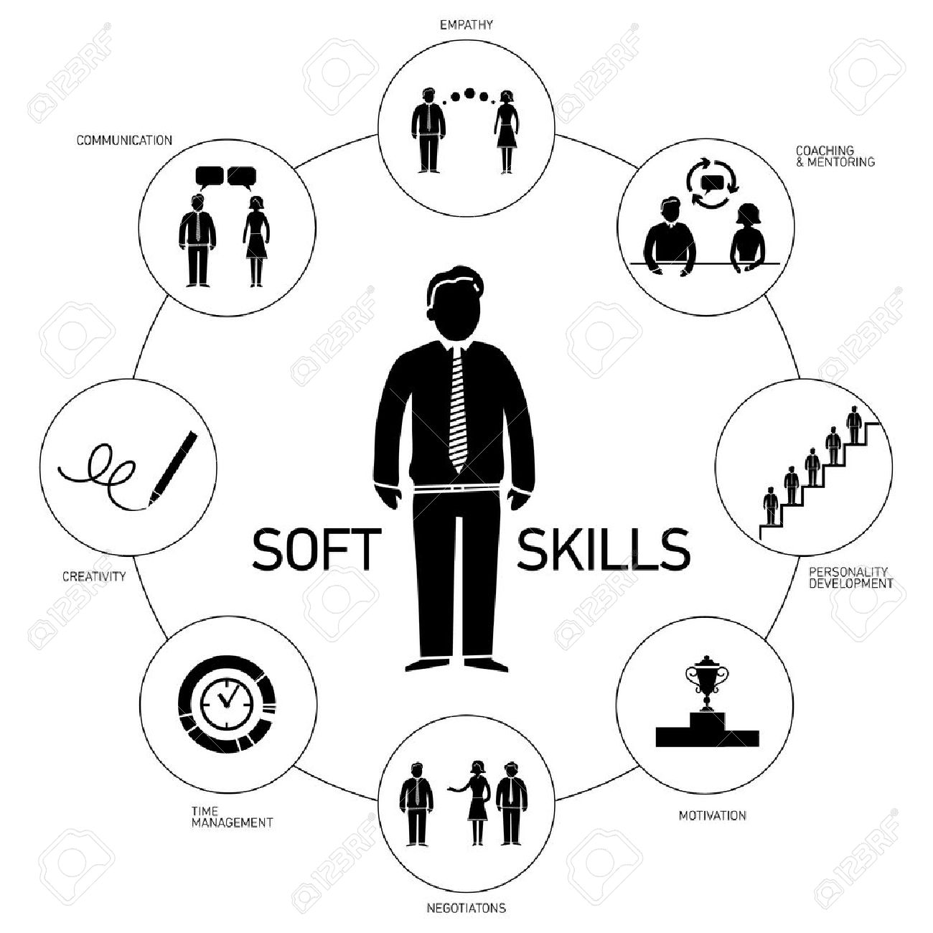

Slide 9
Opportunity Knocks Once

Slide 10
THANK YOU

